Slide 1
COVID-19 Prediction Classifier
Cpts 315 – Introduction to data mining
Nam Jun Lee
Notes:
Hi everyone, my name is Nam Jun Lee and I'm going to explain my CPTS 315 project today.

Slide 2


Motivation
Pandemic disease
Be fast in transmission
Immediate isolation is required when symptoms appear
Notes:
In December 2019, the whole world is still confused by a disease called COVID-19.
COVID-19 is a dangerous disease and the rate of transmission is fast, so people should immediately quarantine when symptoms appear.
Therefore, just as many researchers use artificial intelligence to tell people what symptoms appear when they have COVID-19, I wanted to use machine learning for these pandemic diseases, so I decided to proceed with this COVID-19 prediction classification project.

Slide 3

Precise problem
Classification of COVID-19 through COVID-19 Symptoms
Two categorical attributes of the data used: Yes or No.
Determine whether it's COVID-19 or not from 20 symptoms
Machine Learning method using Scikit-learn
Notes:
The goal of my project is to implement three predictive classifiers through COVID-19 symptoms and then compare the accuracy to find the most optimal model. It is also to find out which symptoms affect COVID-19 through this optimal model.
The dataset used had two types of specific strings yes or no. And it will be used to predict COVID-19 through 20 symptoms.
For this modeling task, I utilized the machine learning library provided by Scikit-learn.

Slide 4
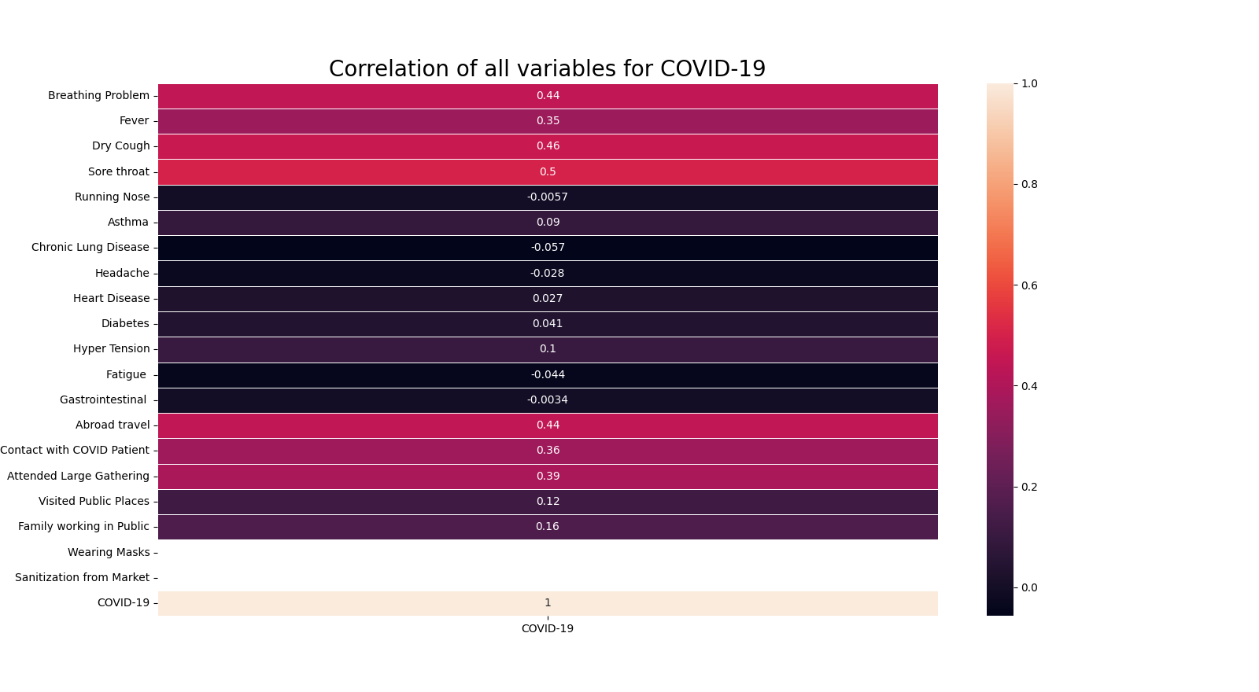
Preprocessing
Remove unnecessary data:
Wearing Masks
Sanitization from Market
Notes:
First, before learning the model, I checked the correlation to remove unnecessary information from the data.
It can be seen that "Wearing Masks" and "Sanitization from Market" have no effect on COVID-19. Therefore, I decided to remove those two variables before fitting the model.

Slide 5
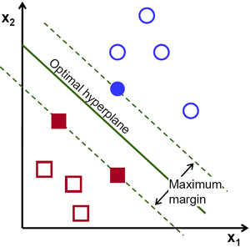
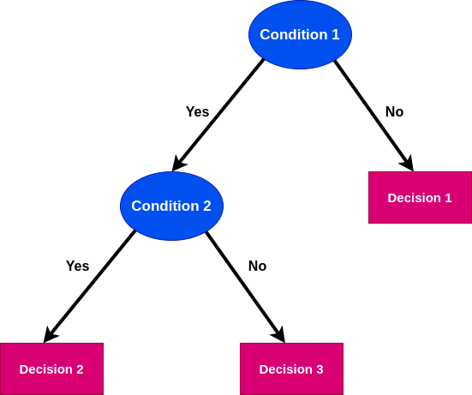
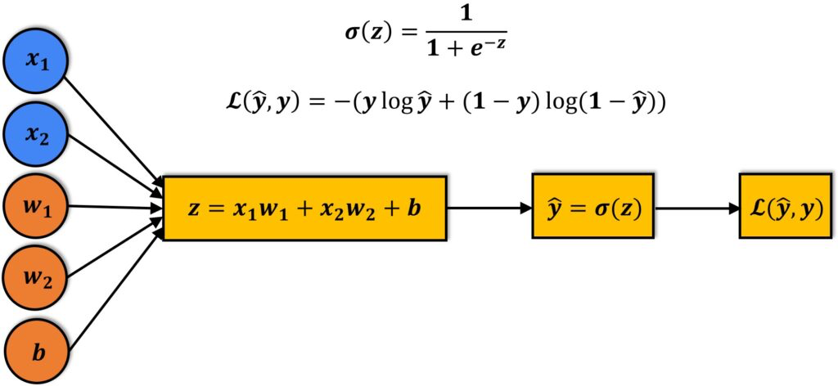
High-level solution methodology
Logistic Regression
SVM
Decision Tree
* Implemented with the Scikit-learn library in Python
Notes:
To proceed with this project, I will apply three classifier models Logistic Regression, Support Vector Machine with linear kernel, and Decision Tree.
Logistic Regression is used to measure the performance of a classification model whose output is a probability value using a cross-entropy loss function.
The SVM can measure performance by first finding a dividing line between the two classes and then checking the hyperplane where each input data belongs.
Decision Tree correspond to supervised learning and are an analysis method that combines patterns existing between data into predictable rules and charts them into decision tree structures.

Slide 6
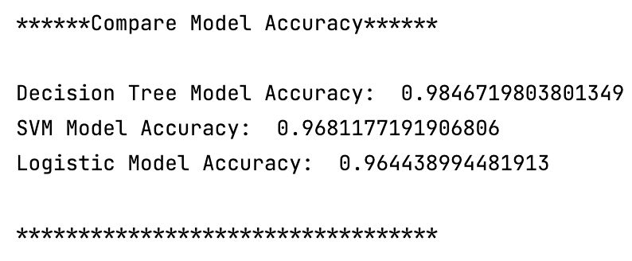
Result 1: Compare model accuracy
OPTIMAL MODEL:
DECISION TREE > SVM > LOGISTIC REGRESSION
Notes:
After fitting the three models, it checked these performance accuracies and found that all three models are highly accurate prediction models with an accuracy of 96% or higher. But the Decision Tree model is the optimal model because this model shows slightly higher accuracy than the two models.

Slide 7
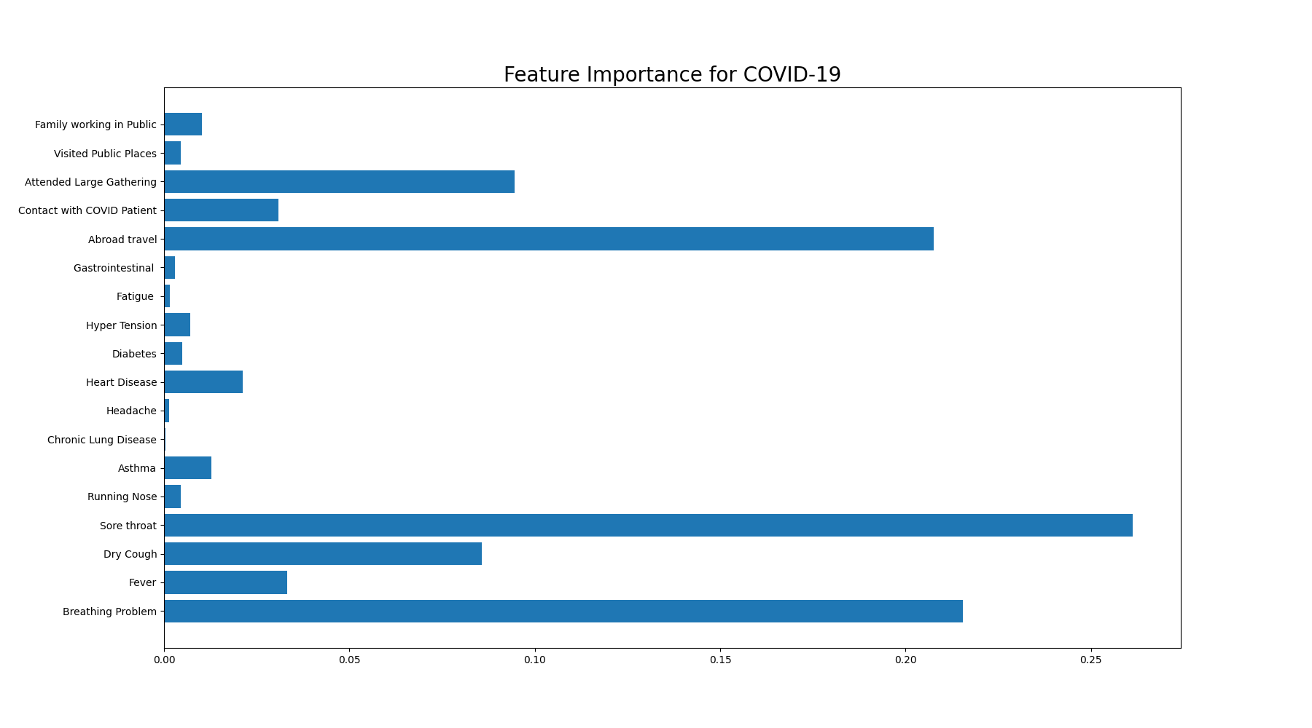
Result 2: Influential Symptoms of COVID-19
Influential:
Sore Throat
Breathing Problem
Aboard Travel
NOT Influential:
Headache
Fatigue
Running Nose
Notes:
As a result of checking the feature importance graph through Decision Tree, there is a high probability of being infected with COVID-19 when there are physical symptoms such as "Sore throat”, "Breathing Problem”, and "Aboard travel”.
And also, it can be seen that physical symptoms such as "Headache”, ”Fatigue”, and "Running Nose" are not very related to COVID-19 infection.
These results show that the use of the Decision Tree classifier in predicting COVID-19 is effective and can be used to develop programs that help predict COVID-19 infection by identifying symptoms when infected.

